Slide 1
AI+BD ML Lab. Day 2
March 23rd, 2021
Training Methodologies with Logistic Regression
Jio Gim <jio.gim@postech.edu>

Slide 2
Today’s Goals
Basic Flow of DL
Flow Diagram & Code Example
Apply to Logistic Regression
Basic Training Techniques
Weight Initialization
Hyper-parameter Searching
Apply to Logistic Regression

Slide 3
Goals
Understanding basic flow of deep learning & code
Applying (1) to the logistic regression model with mini-batch SGD
Understanding the differences from weight initialization
Finding proper hyper-parameters to get fast convergence speed

Slide 4
Basic Flow of DL
Initializing Hyper-params
Data Loading & Preprocessing
Function Definition
Training Iteration
Saving Final Model
Updating Hyper-params
Result Analysis

Slide 5
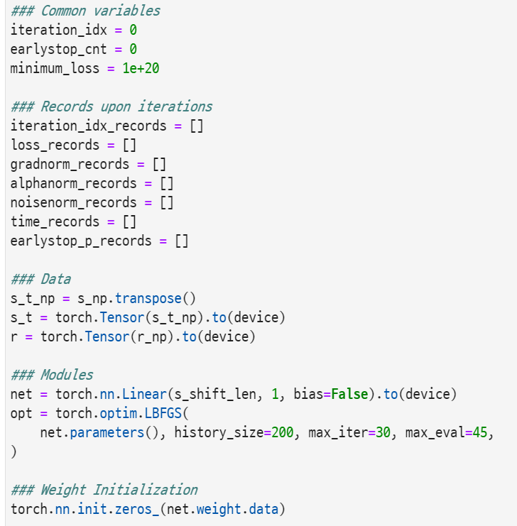
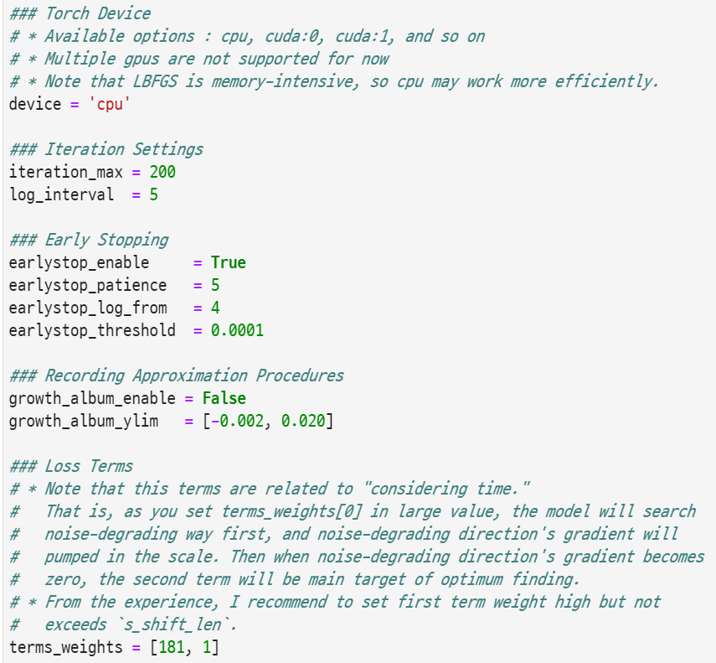
Basic Flow with <code />
Hyper-parameter Initialization
Initializing Hyper-params
Data Loading & Preprocessing
Function Definition
Training Iteration
Saving Final Model
Updating Hyper-params
Result Analysis
◀ Initialization code ▶

Slide 6
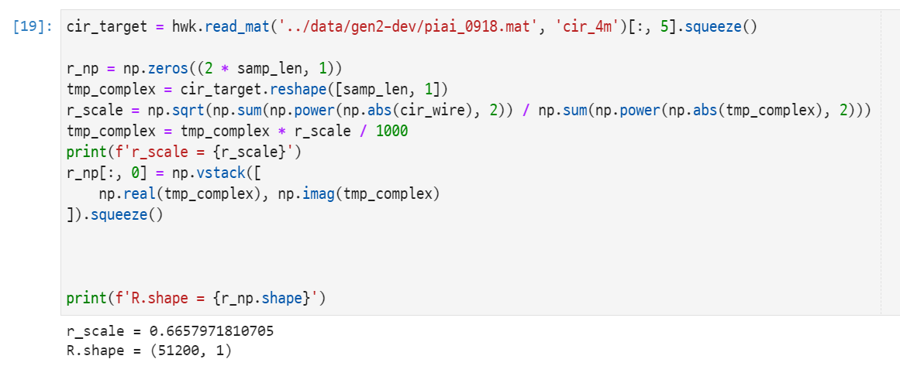
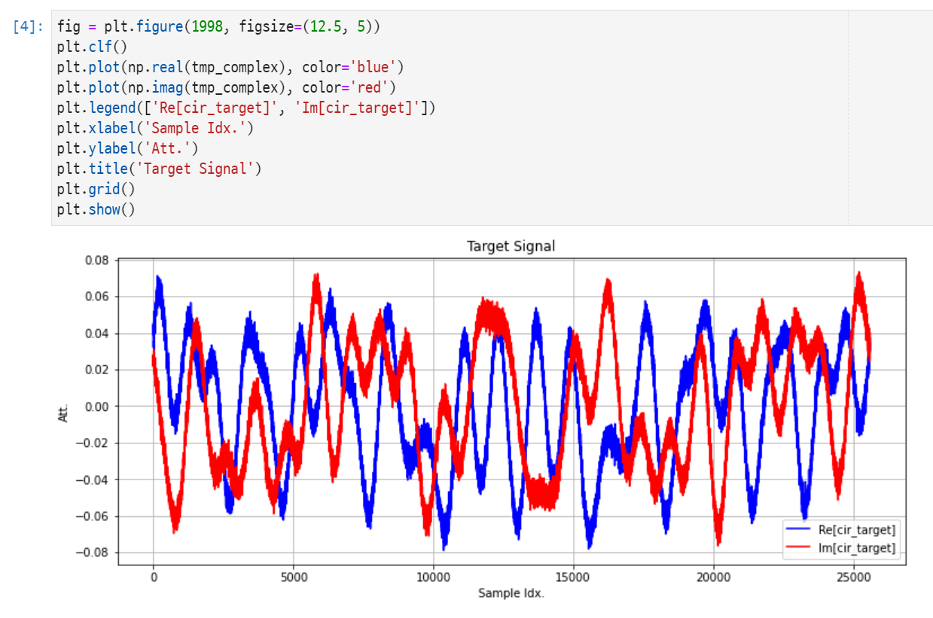
Basic Flow with <code />
Data Load & Preprocessing
Initializing Hyper-params
Data Loading & Preprocessing
Function Definition
Training Iteration
Saving Final Model
Updating Hyper-params
Result Analysis
▲ Loading MATLAB .mat file & Automatically scaling data
Check your data after preprocessing! ▶

Slide 7
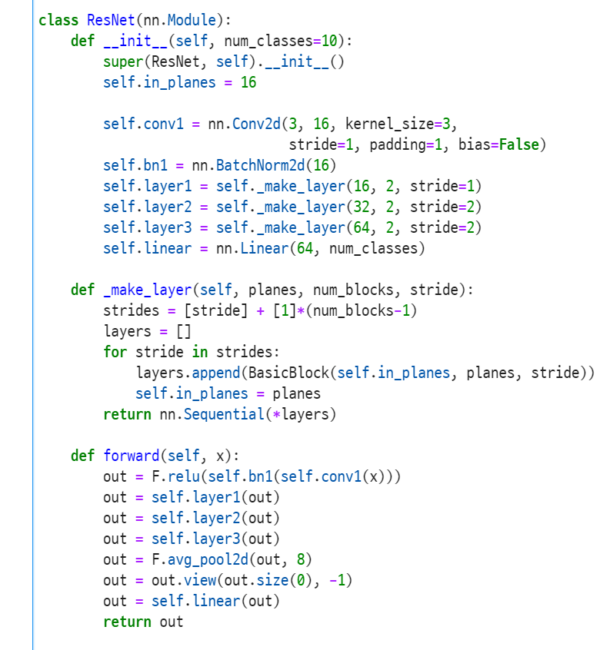
Basic Flow with <code />
Function Definition
Initializing Hyper-params
Data Loading & Preprocessing
Function Definition
Training Iteration
Saving Final Model
Updating Hyper-params
Result Analysis
What functions can be defined?
model class
◀ Defined ResNet model class inheriting torch.nn.Module

Slide 8
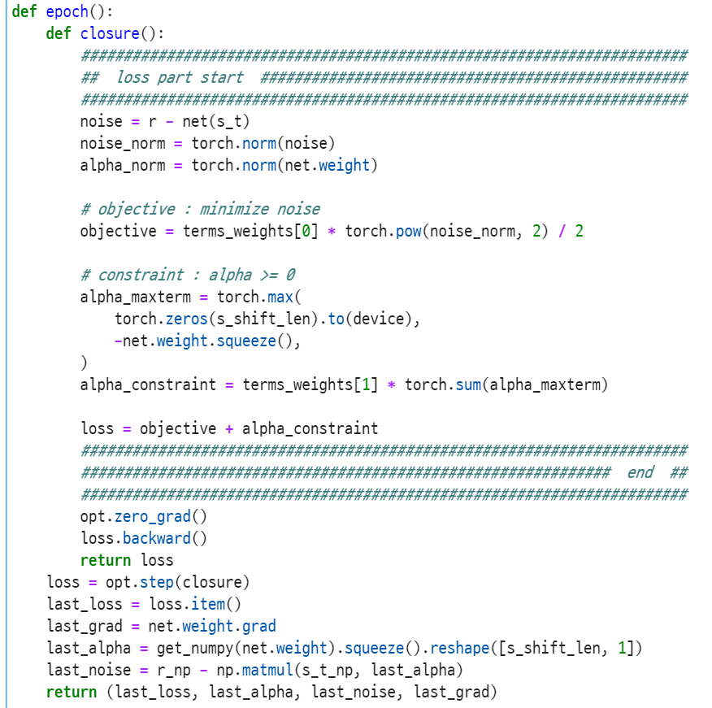
Basic Flow with <code />
Function Definition
Initializing Hyper-params
Data Loading & Preprocessing
Function Definition
Training Iteration
Saving Final Model
Updating Hyper-params
Result Analysis
What functions can be defined?
model class
epoch function
◀ Defined epoch function

Slide 9
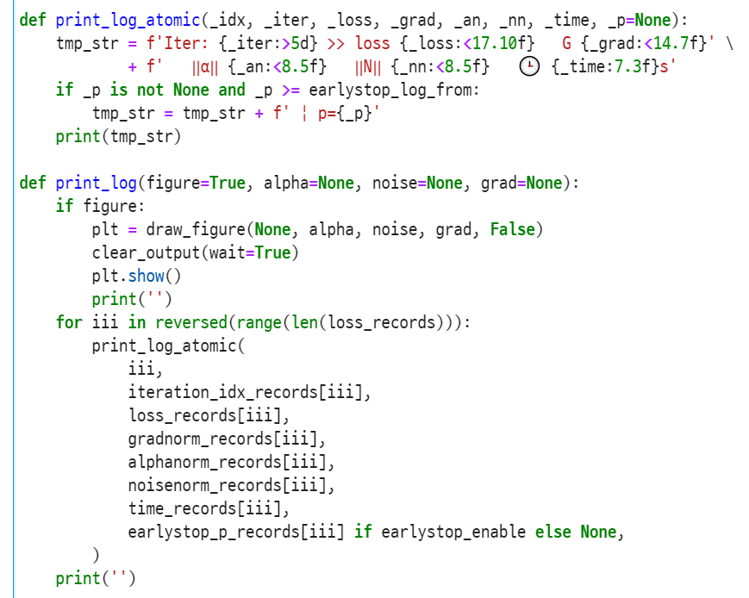
Basic Flow with <code />
Function Definition
Initializing Hyper-params
Data Loading & Preprocessing
Function Definition
Training Iteration
Saving Final Model
Updating Hyper-params
Result Analysis
What functions can be defined?
model class
epoch function
logging function
◀ Defined logging function

Slide 10
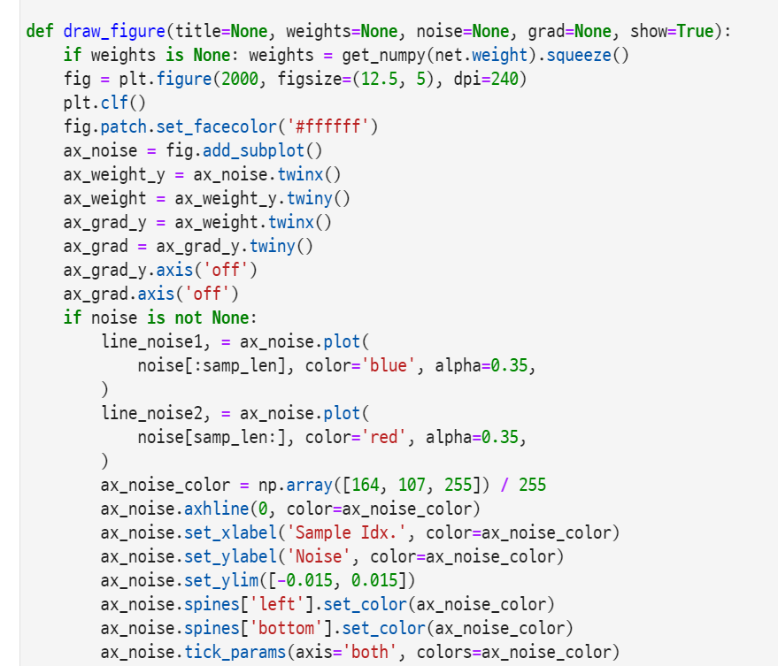
Basic Flow with <code />
Function Definition
Initializing Hyper-params
Data Loading & Preprocessing
Function Definition
Training Iteration
Saving Final Model
Updating Hyper-params
Result Analysis
What functions can be defined?
model class
epoch function
logging function
plotting function
You can make other things into a function, of course~
◀ Defined plotting function

Slide 11
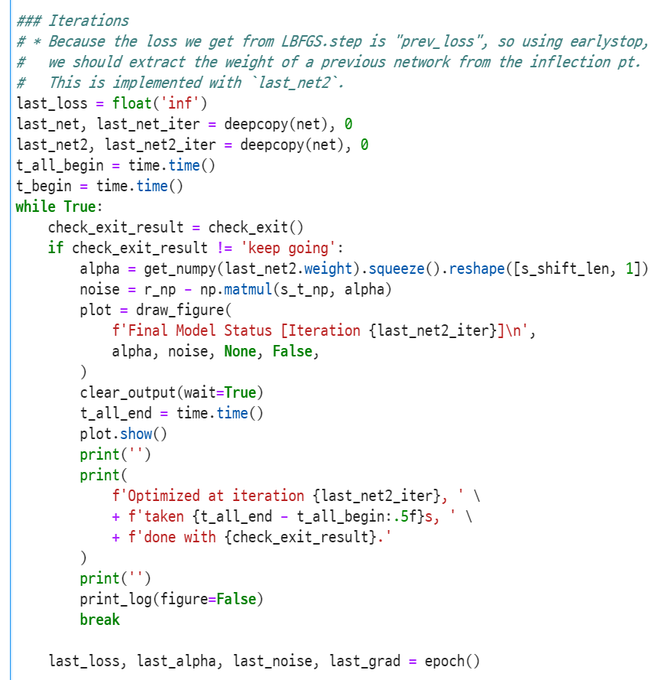
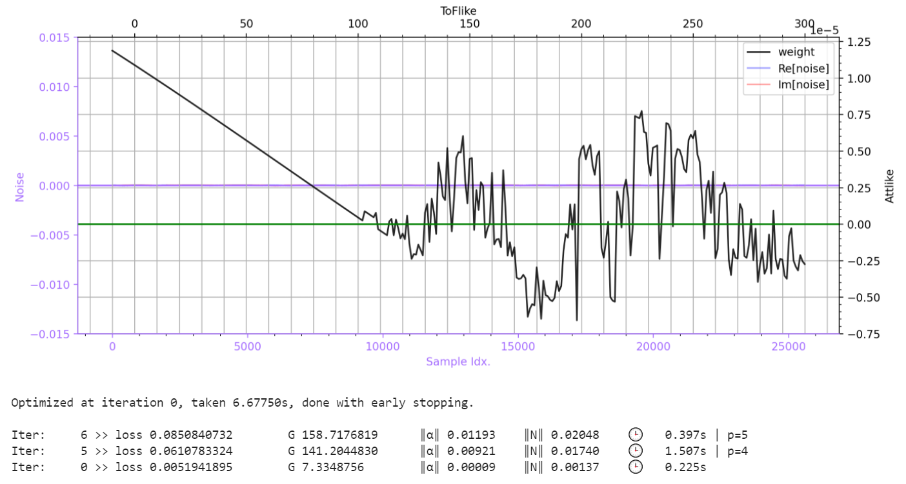
Basic Flow with <code />
Training Iteration
Initializing Hyper-params
Data Loading & Preprocessing
Function Definition
Training Iteration
Saving Final Model
Updating Hyper-params
Result Analysis
Training … output ▶
◀ Training iteration while

Slide 12
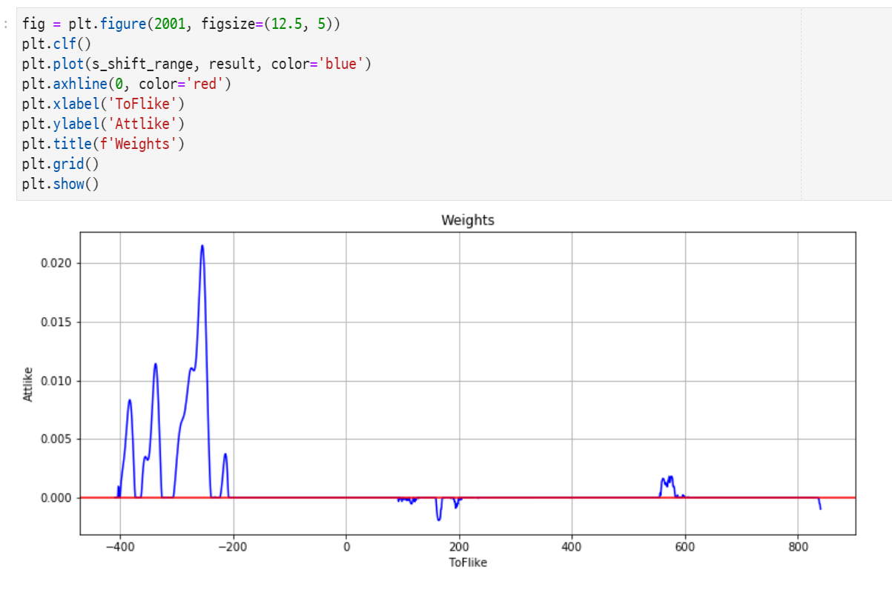
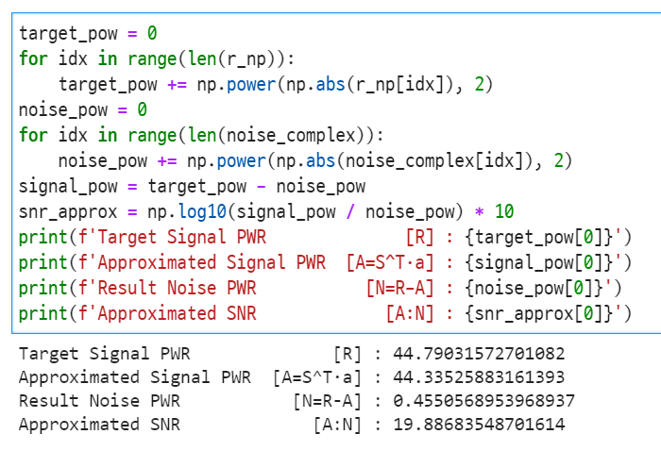
Basic Flow with <code />
Result Analysis
Initializing Hyper-params
Data Loading & Preprocessing
Function Definition
Training Iteration
Saving Final Model
Updating Hyper-params
Result Analysis
◀ Result analysis ▶

Slide 13

Basic Flow with <code />
Updating Hyper-parameters
Initializing Hyper-params
Data Loading & Preprocessing
Function Definition
Training Iteration
Saving Final Model
Updating Hyper-params
Result Analysis
No code, do this by your self.

Slide 14
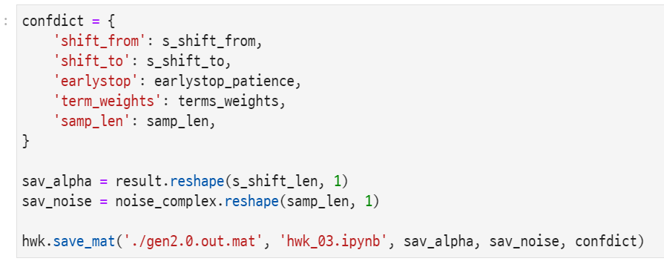

Basic Flow with <code />
Saving Final Model
Initializing Hyper-params
Data Loading & Preprocessing
Function Definition
Training Iteration
Saving Final Model
Updating Hyper-params
Result Analysis
▲ Saving model as .mat for further investigation

Slide 15
Backgrounds
For your information & reminding

Slide 16
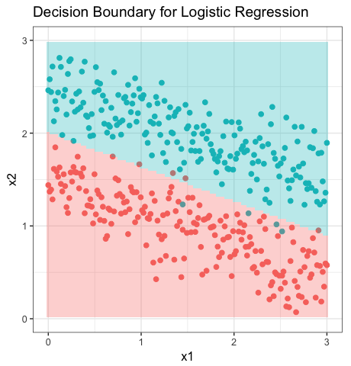
Logistic Regression = “Linear Logistic Regression”
Regression = “Fitting”
Logistic = “Linear Logistic”
Decision boundary to be learned is linear
But output is not “score”, but logistic probability (softmax)
Logistic value is more fit to real world’s probability than linear score
Let’s go

Slide 17
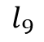
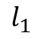
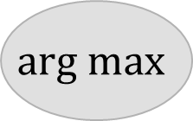
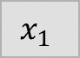
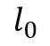
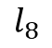
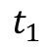
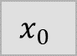
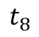


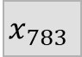
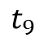

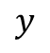
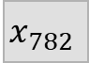

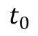
How is LR expressed in learning model?
SOFTMAX
NLLLoss
$$x_{0}$$
$$Σ$$
$$l_{0}$$
$$t_{0}$$
$$x_{1}$$
$$Σ$$
$$l_{1}$$
$$t_{1}$$
…
with weights
…
…
$$x_{782}$$
$$Σ$$
$$l_{8}$$
$$t_{8}$$
Back
Propagation
$$x_{783}$$
$$Σ$$
$$l_{9}$$
$$t_{9}$$
Linear Regression
CrossEntropyLoss in PyTorch
$$arg max$$
$$y$$

Slide 18

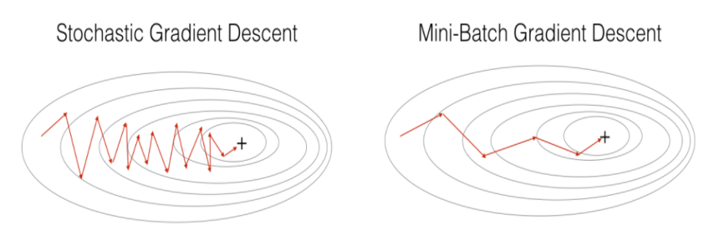
Stochastic Gradient Descent
Because we randomly pick dataset to train
Gradient Descent
Stochastic Gradient Descent

Slide 19
Mini-batch Stochastic Gradient Descent
Why Mini-batch SGD?
SGD samples 1 data from dataset at each iteration
This one-shot learning makes learning oscillate!
So put more data pair and accumulate gradients!
Mini-batch SGD samples many data at each iteration
How about learn all data pair at an iteration?
Good approach, so-called “Batch SGD”! But…
It takes a lot of time and memory to learn all data pair when dataset becomes larger
Hard to overcome local optimal
Stochastic Gradient Descent
Mini-batch SGD

Slide 20
Summary
We gonna attach “logistic function” so that the linear regression model can do classification task!
We gonna give a dataset of specified size (not all !) for better gradient descent performance!

Slide 21
It’s coding time
Let’s fill the I.P.Y.N.B

Slide 22
Preparation
PDF Version of this PPT :
https://laf.gg/aibd-pdf-2
Base .ipynb :
https://laf.gg/aibd-py-2
Required Python Packages :
matplotlib numpy scikit-learn
torch torchvision seaborn

Slide 23
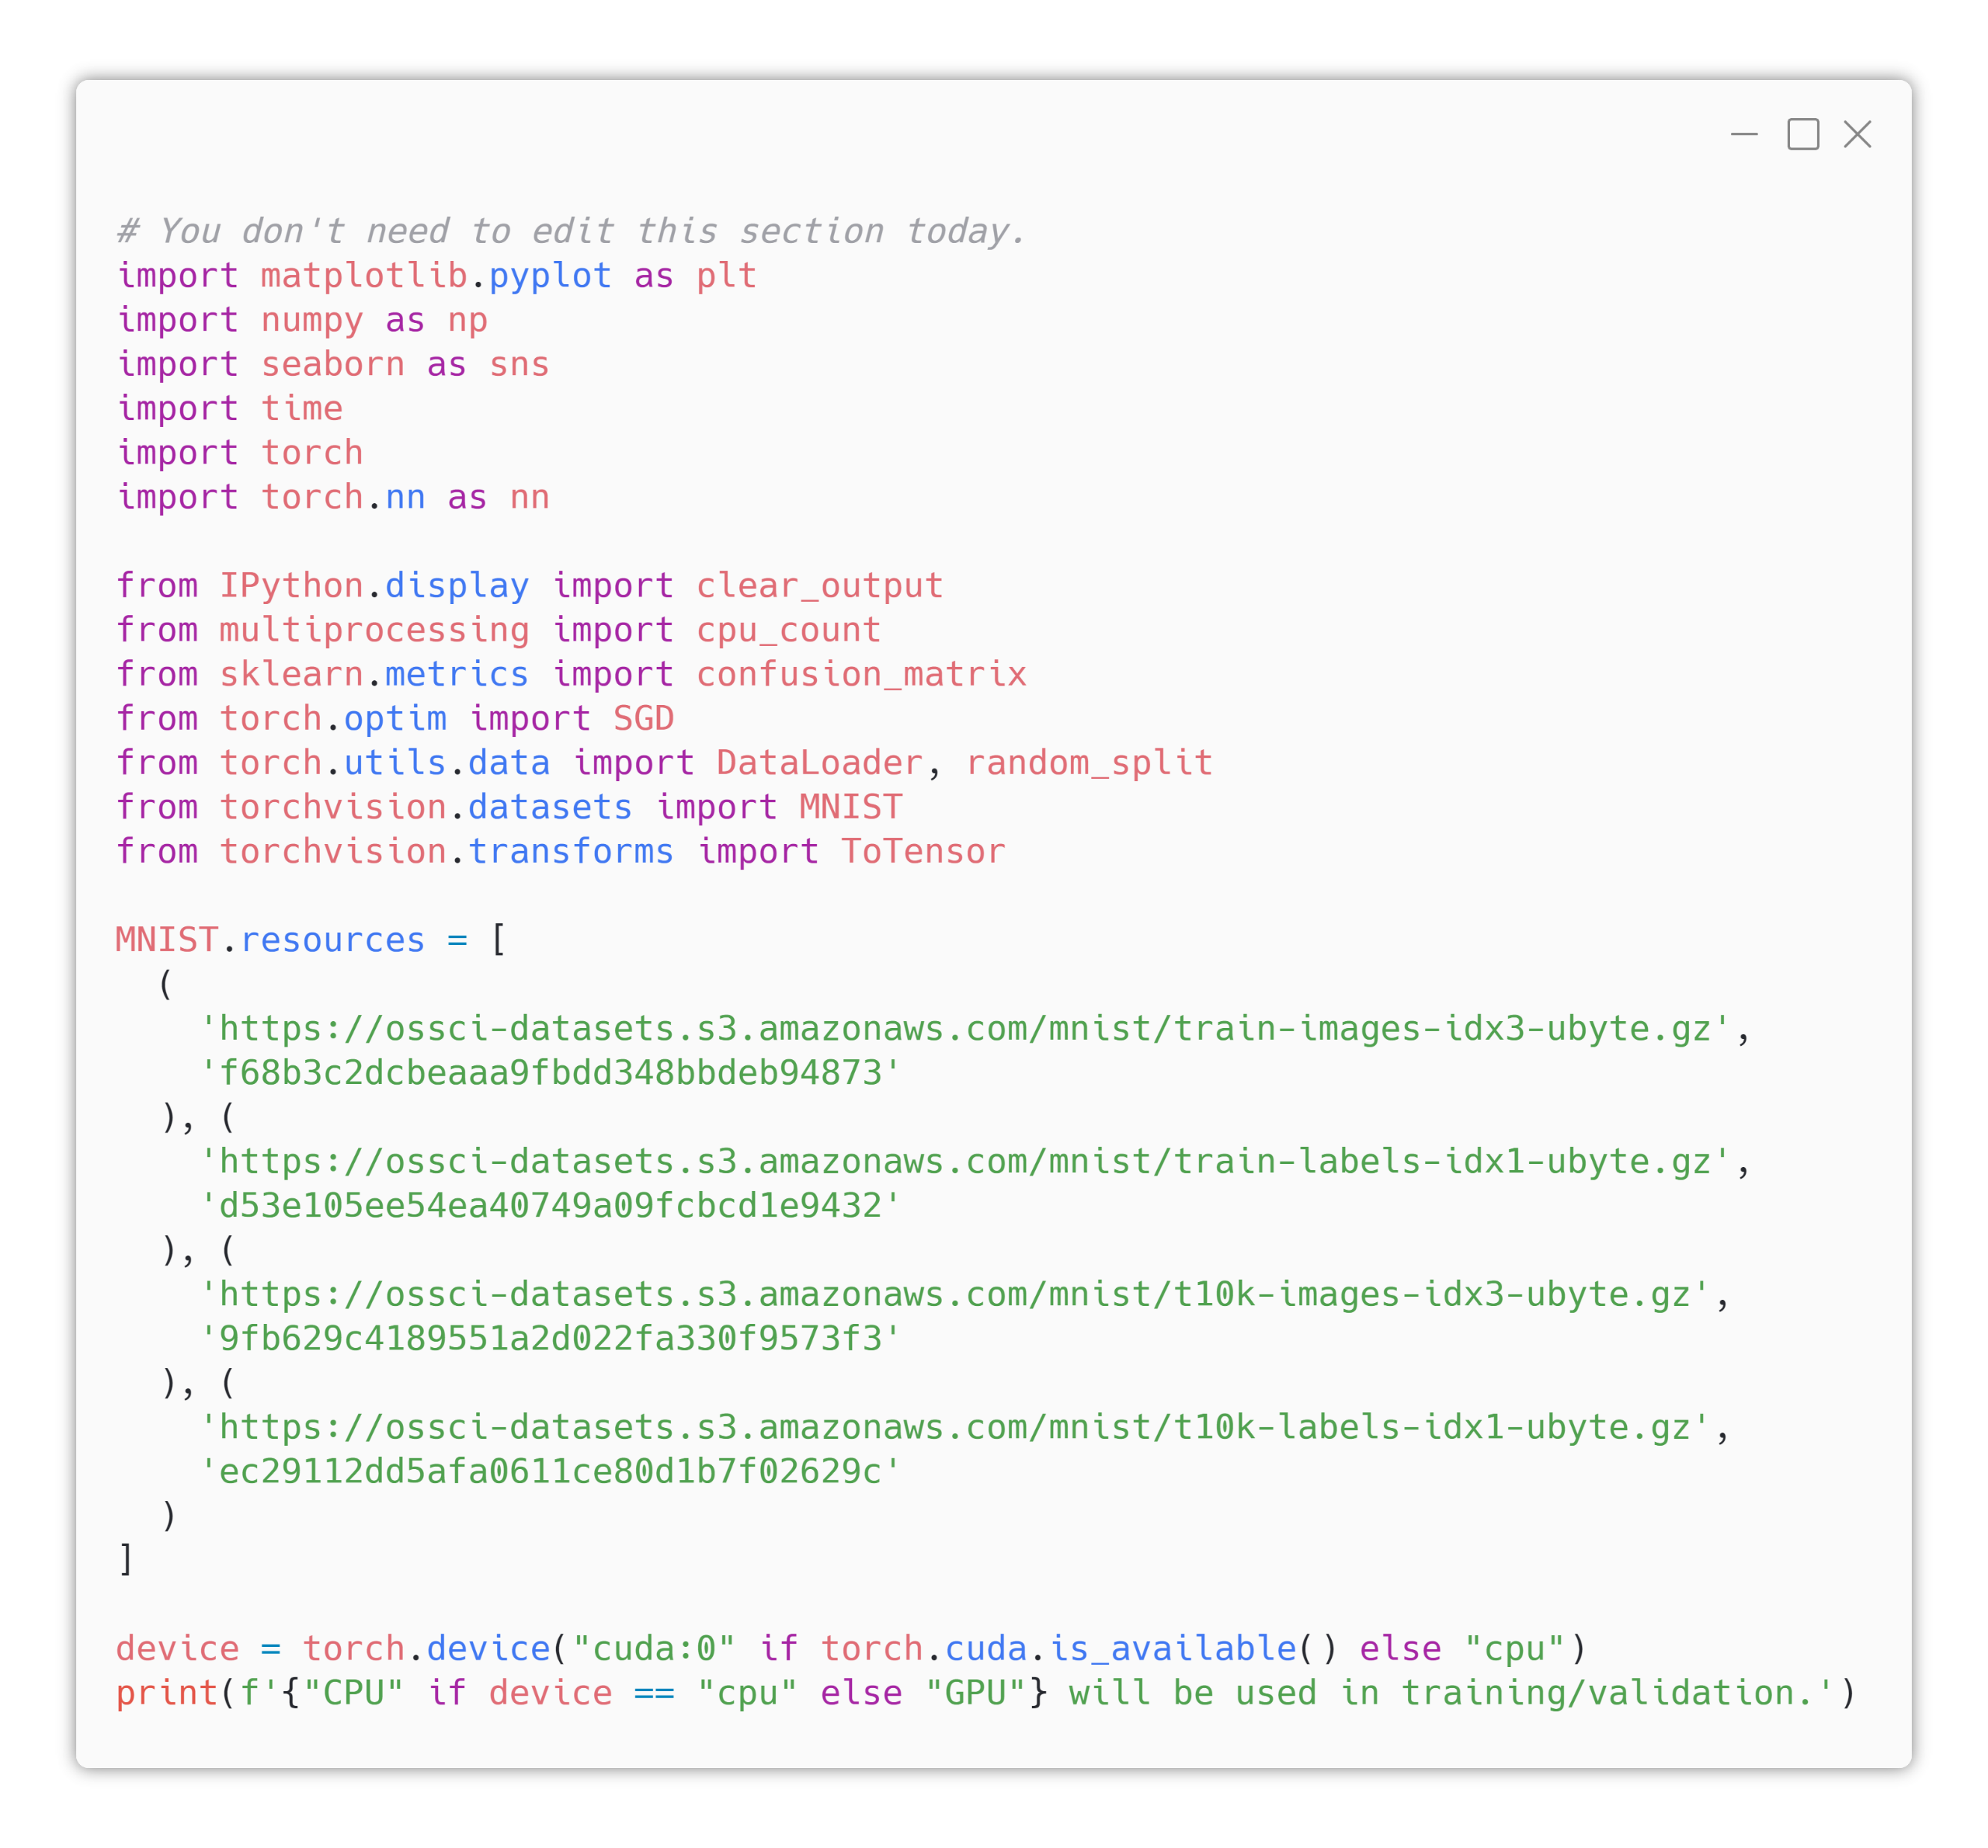
1. Library Importation & Device Preparation
Already prepared for you!
Dataset URL in torchvision package is outdated
So temporarily replaced source URL
Future torchvision package will contain working URLs

Slide 24
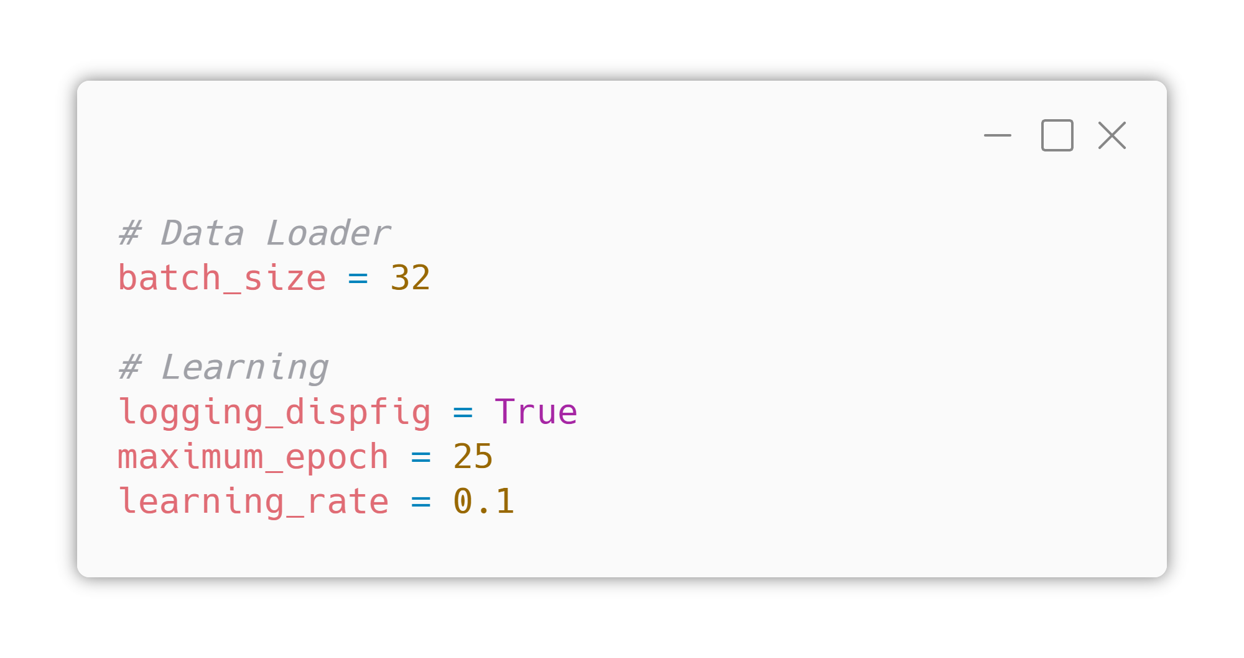
2. Hyper- Parameters
Already prepared for you!
This section is generally filled during coding, but let’s fill it in advance today.
batch_size : the number of dataset in one mini-batch (generally a multiple of 2)
logging_dispfig : switch for displaying learning graph during training
maximum_epoch : training epoch count
learning_rate : learning rate what you know

Slide 25
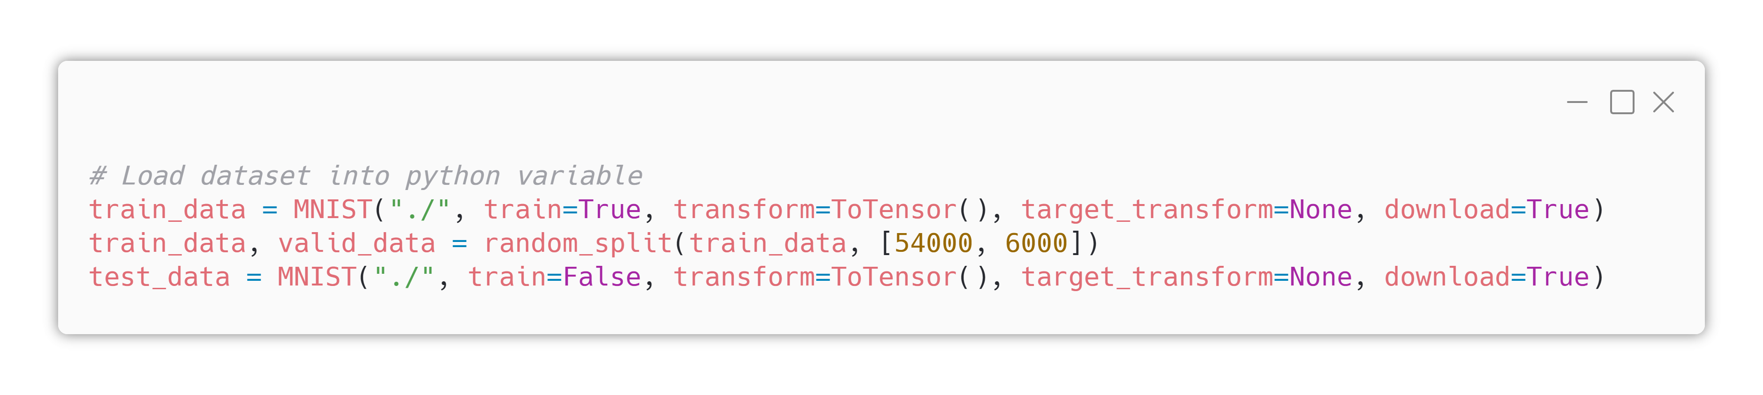
3. Data Load & Preprocessing
But no preprocessing today.
Download training dataset
ToTensor?
Original dataset is in form of “PIL (Python Image Library)” image, so using torchvision.transforms.ToTensor() we can convert the image into torch Tensor.

Slide 26
3. Data Load & Preprocessing
But no preprocessing today.
Split train dataset to training set & validation set (ratio = 9:1)
Download test dataset
Datasets
train_data : dataset used at gradient descent (real training)
valid_data : dataset used to check learning progress
test_data : dataset used to evaluate performance of model

Slide 27
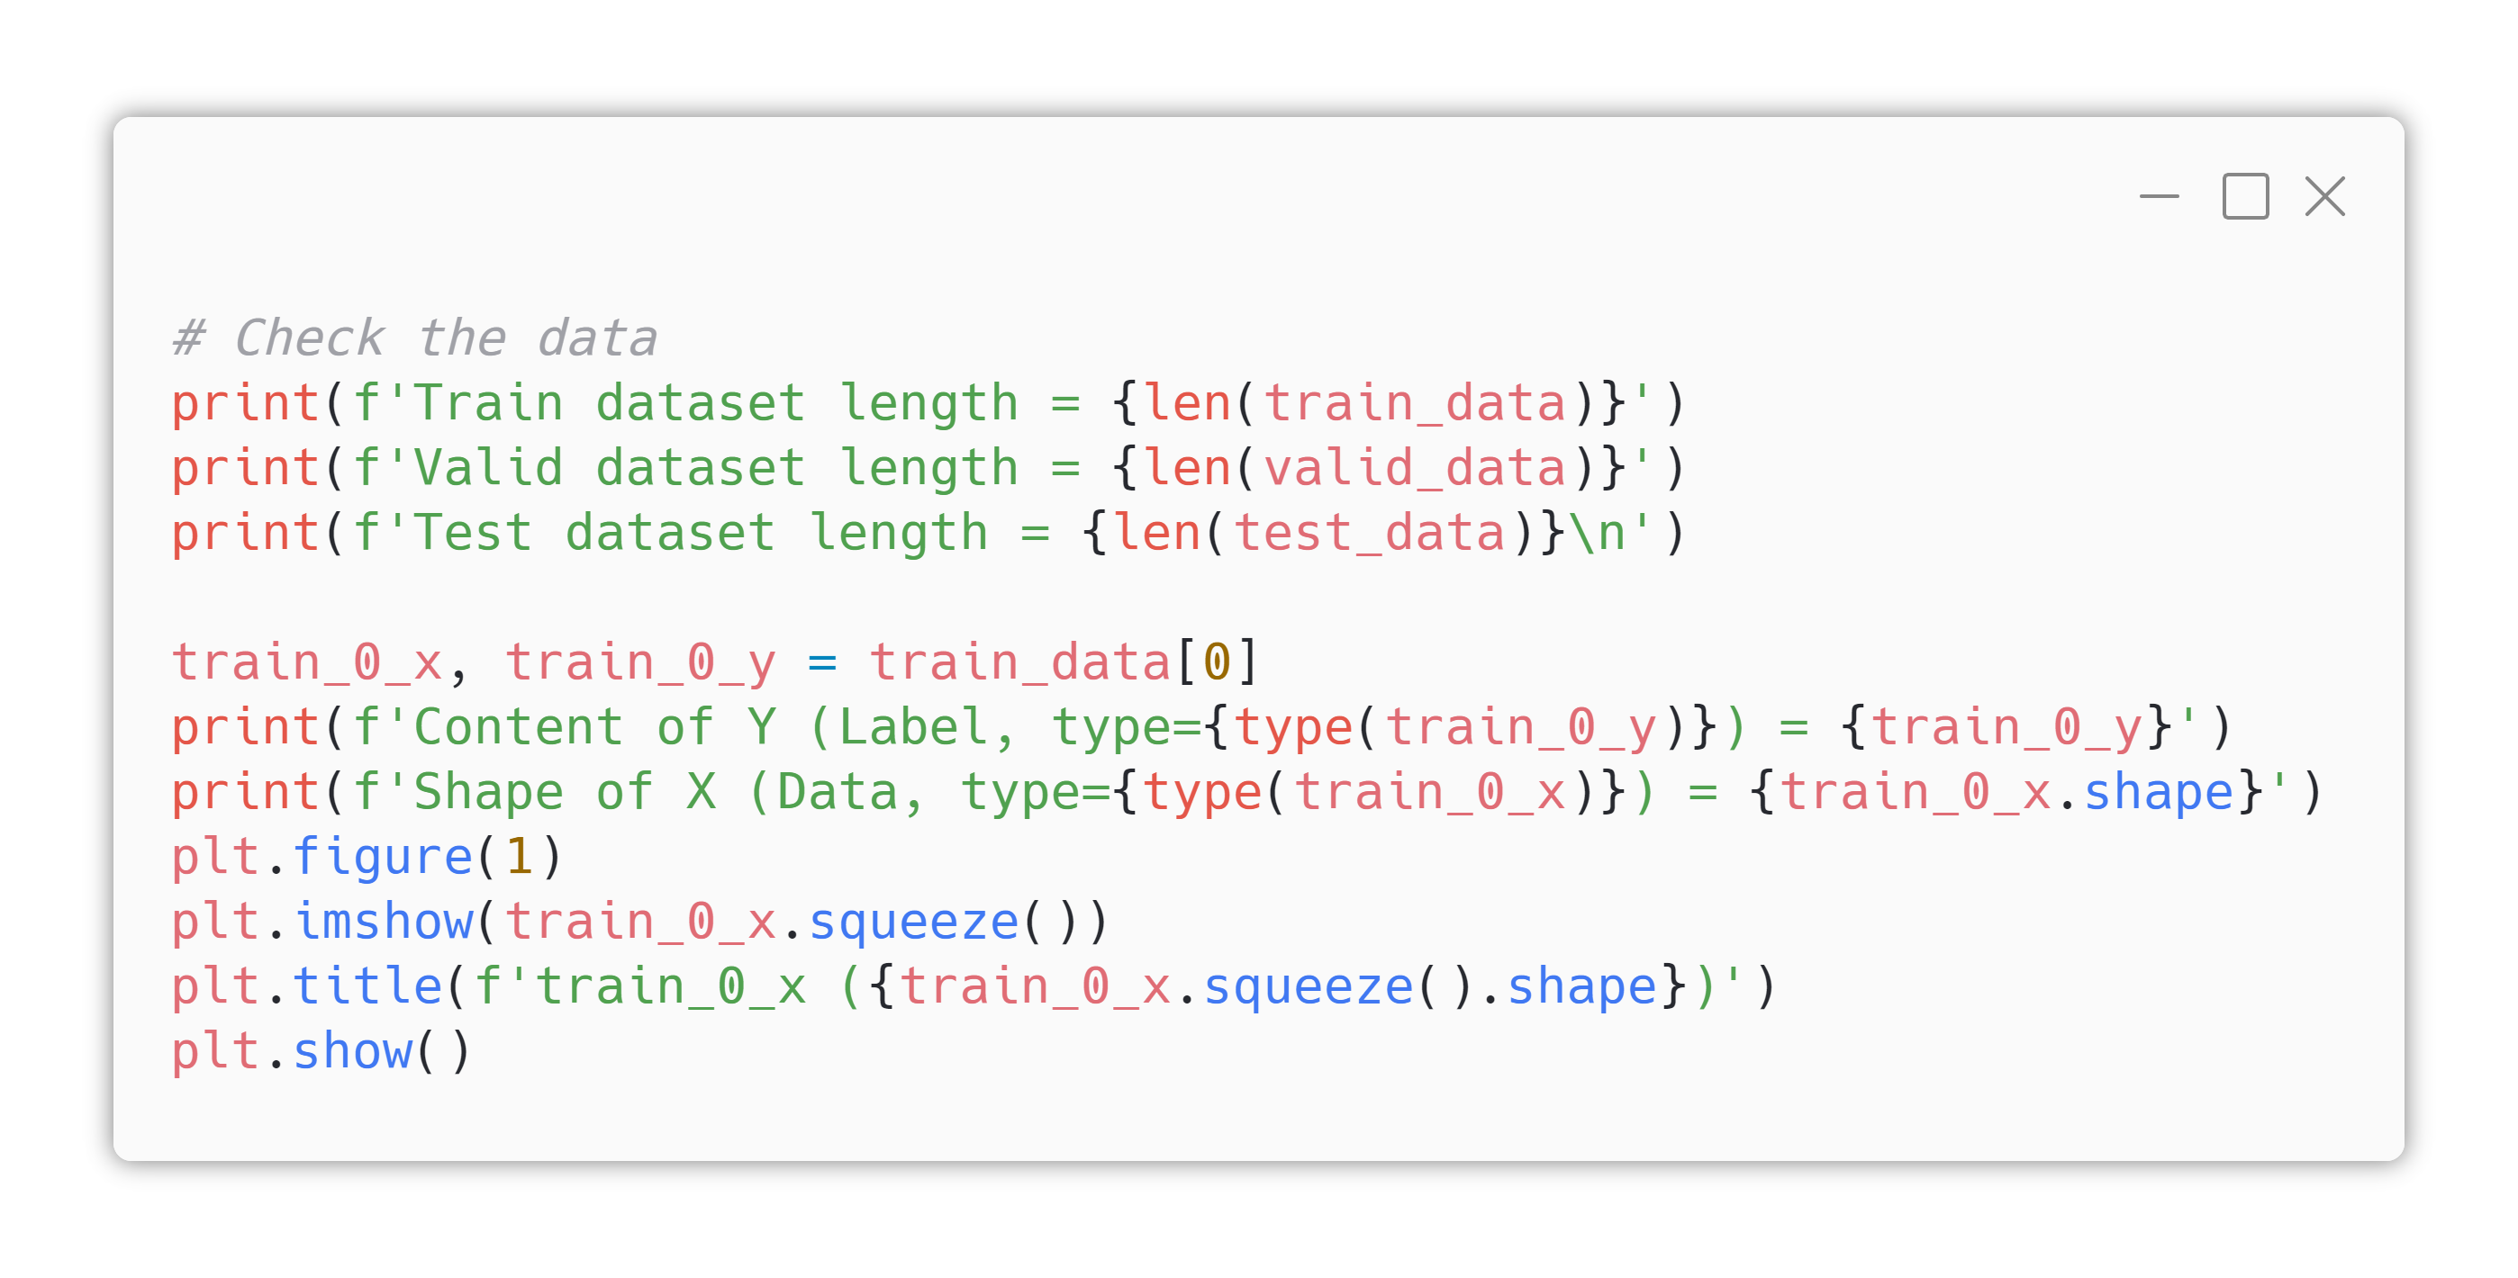
3. Data Load & Preprocessing
But no preprocessing today.
Python Template Literal <f> Basic
From python 3.6, template literal <f> is supported
Write <f> before opening apostrophe
In string, use {variable} to embed variable

Slide 28
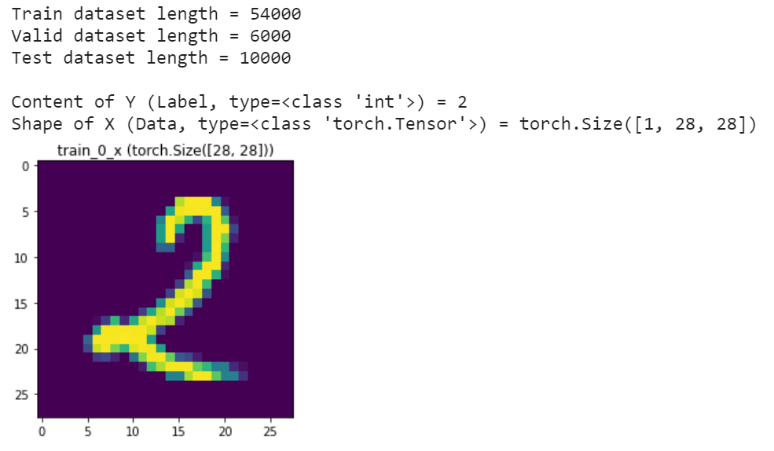
3. Data Load & Preprocessing
But no preprocessing today.
=
Expected Output
Check “Content of Y” equals with the picture

Slide 29
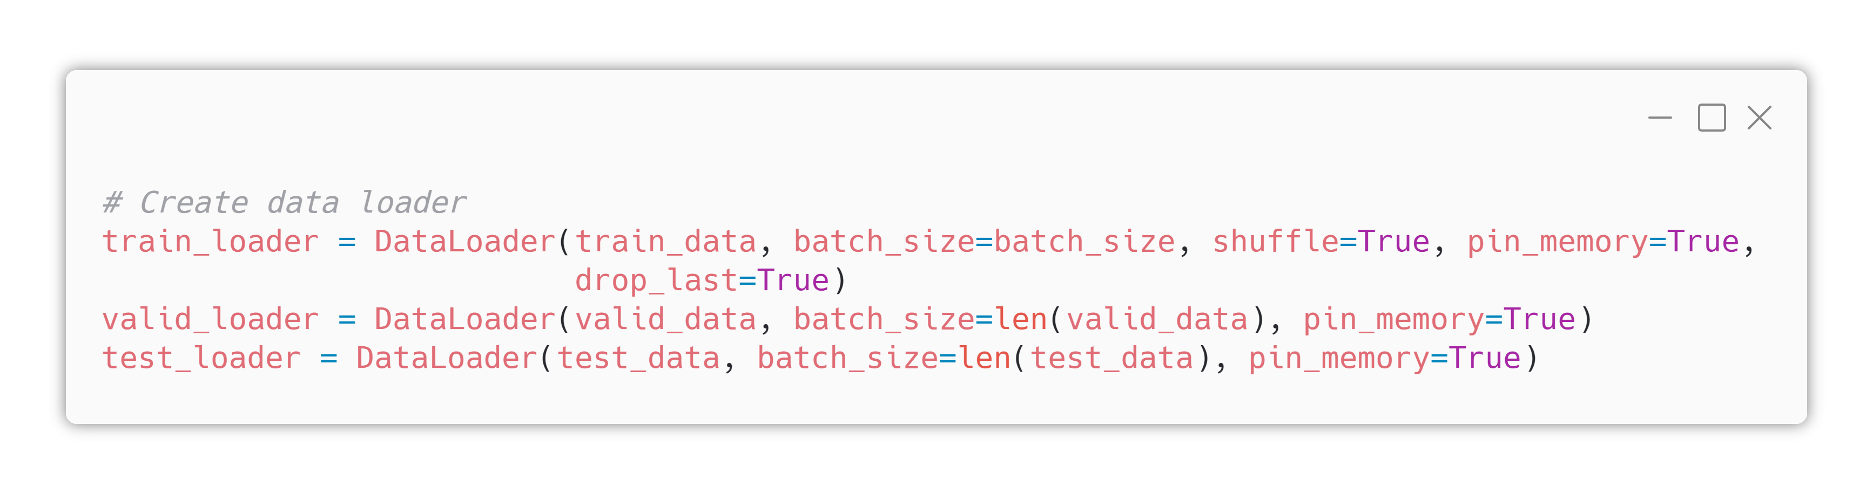
3. Data Load & Preprocessing
shuffle option
if True, DataLoader will shuffle dataset every epoch
But no preprocessing today.
DataLoader (torch.utils.data.DataLoader)
Useful wrapper for data feeding
Cut dataset based on batch_size → We are implementing mini-batch using this feature
Make dataset into “Python Iterable object” → We can call enumerate(), iter() on DataLoader

Slide 30
3. Data Load & Preprocessing
drop_last option
when dataset length is not a multiple of batch_size, if drop_last=True, it drops last small data.
Example) len(dataset)=38, batch_size=16 ⇒ 6 data pairs will not be used
But no preprocessing today.
pin_memory option
when use CUDA, if True, dataset will be fixed on CUDA memory

Slide 31
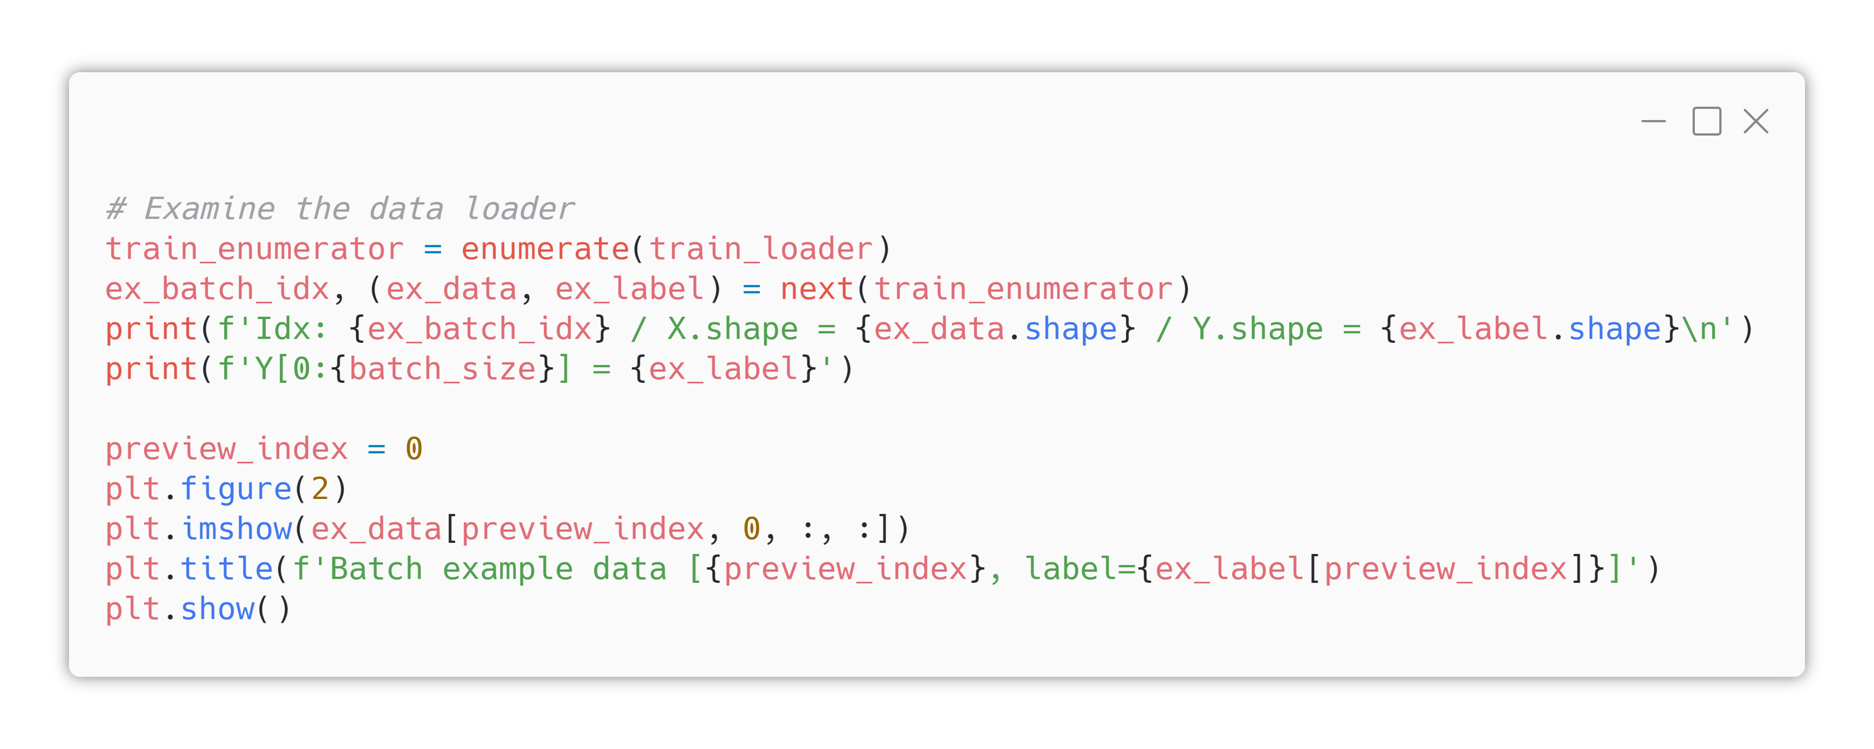
3. Data Load & Preprocessing
enumerate function
make an enumerator who iterates Iterable with index
Enumerator will return (index, content) tuple(pair)
But no preprocessing today.

Slide 32
3. Data Load & Preprocessing
next function
iterate enumerator and returns (index, content) tuple
In this case, content is (data,label) pair, so unpacked
But no preprocessing today.

Slide 33
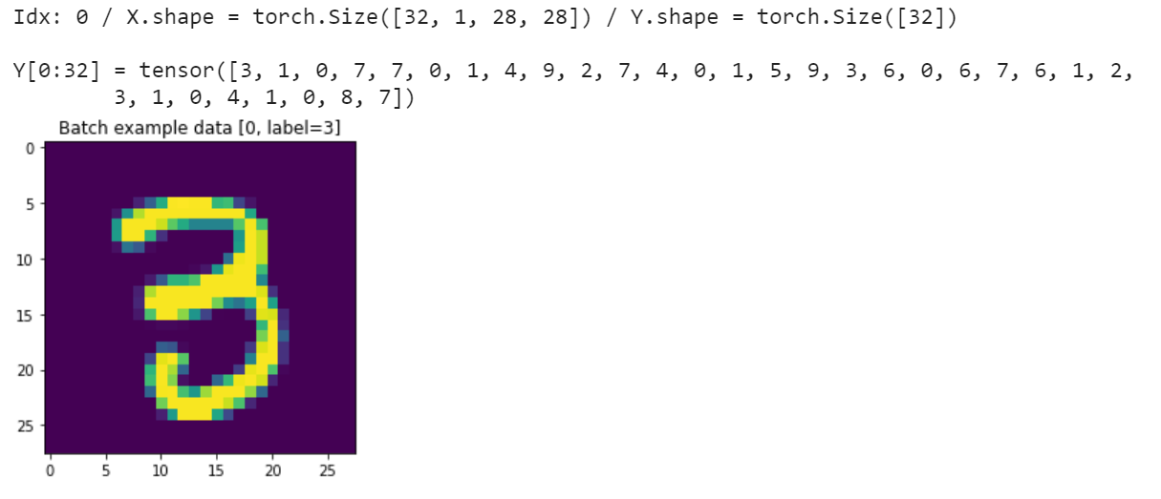
3. Data Load & Preprocessing
But no preprocessing today.
Expected Output
Check label equals with the picture

Slide 34
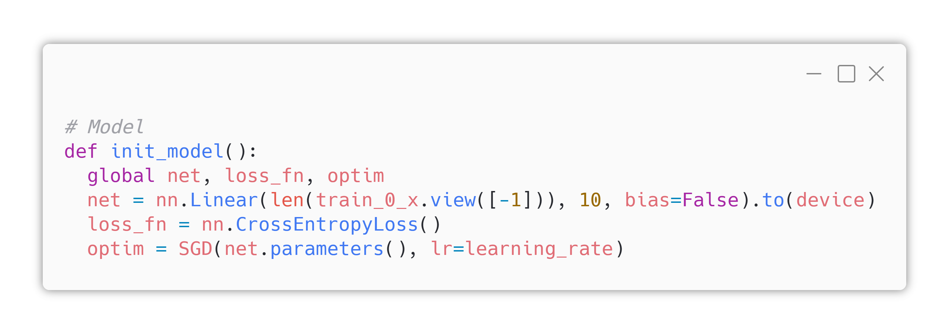
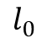
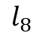



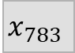

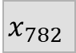


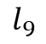
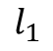
4. Function Definitions
Defining Model
$$x_{0}$$
$$Σ$$
$$l_{0}$$
$$x_{1}$$
$$Σ$$
$$l_{1}$$
…
with weights
…
$$x_{782}$$
$$Σ$$
$$l_{8}$$
$$x_{783}$$
$$Σ$$
$$l_{9}$$

Slide 35
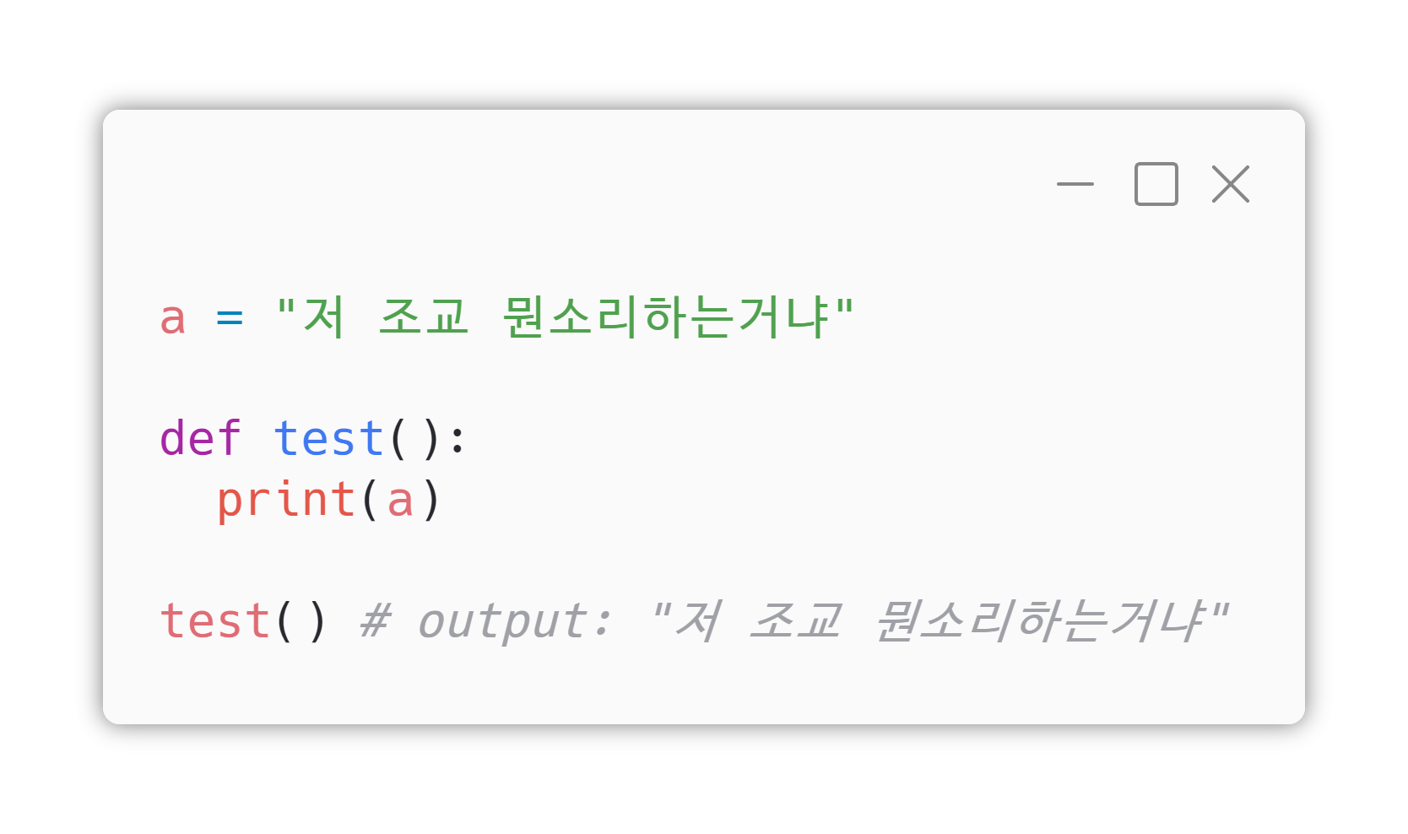
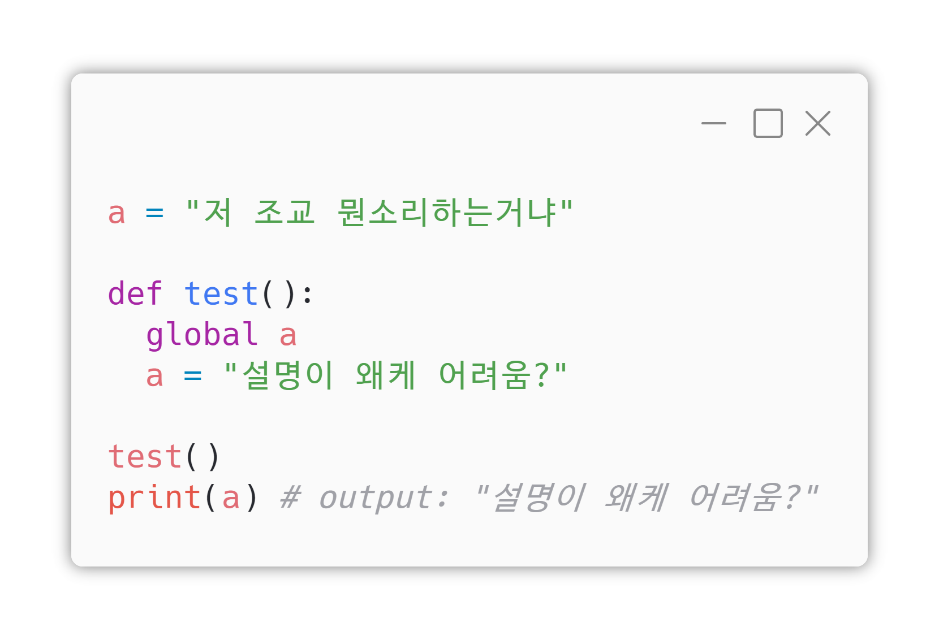
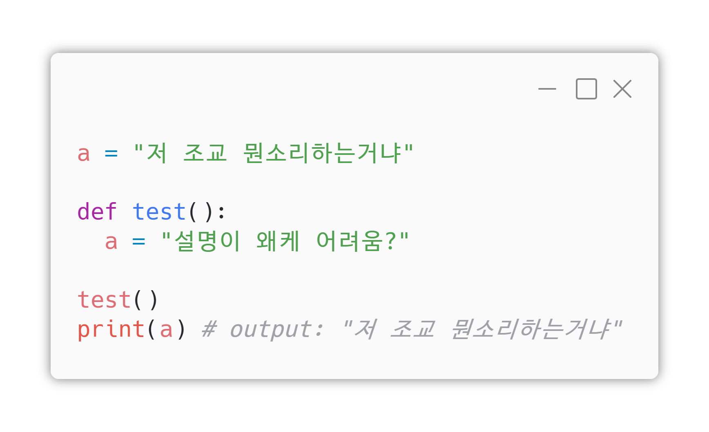
4. Function Definitions
FYI : <global> keyword in Python
Without global, a function can read variables declared outside (“global variables”)
With global, a function now can read & write to global variables
Defining Model

Slide 36
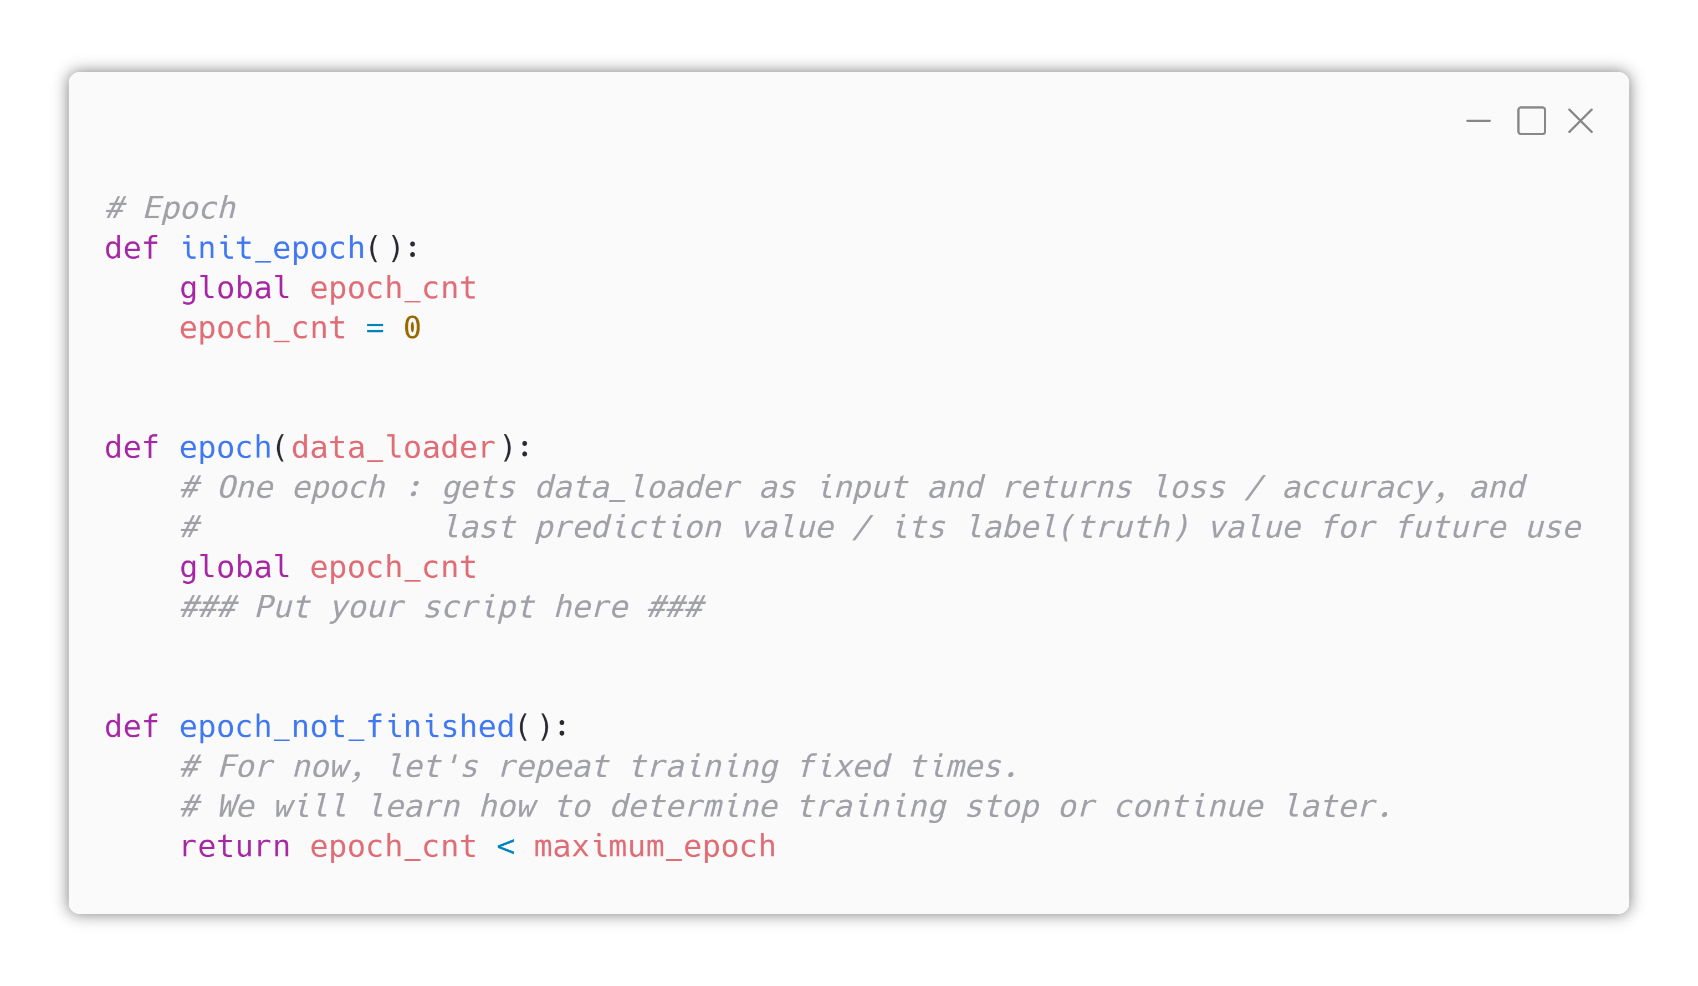

4. Function Definitions
Defining Epoch Functions
Next Page!

Slide 37
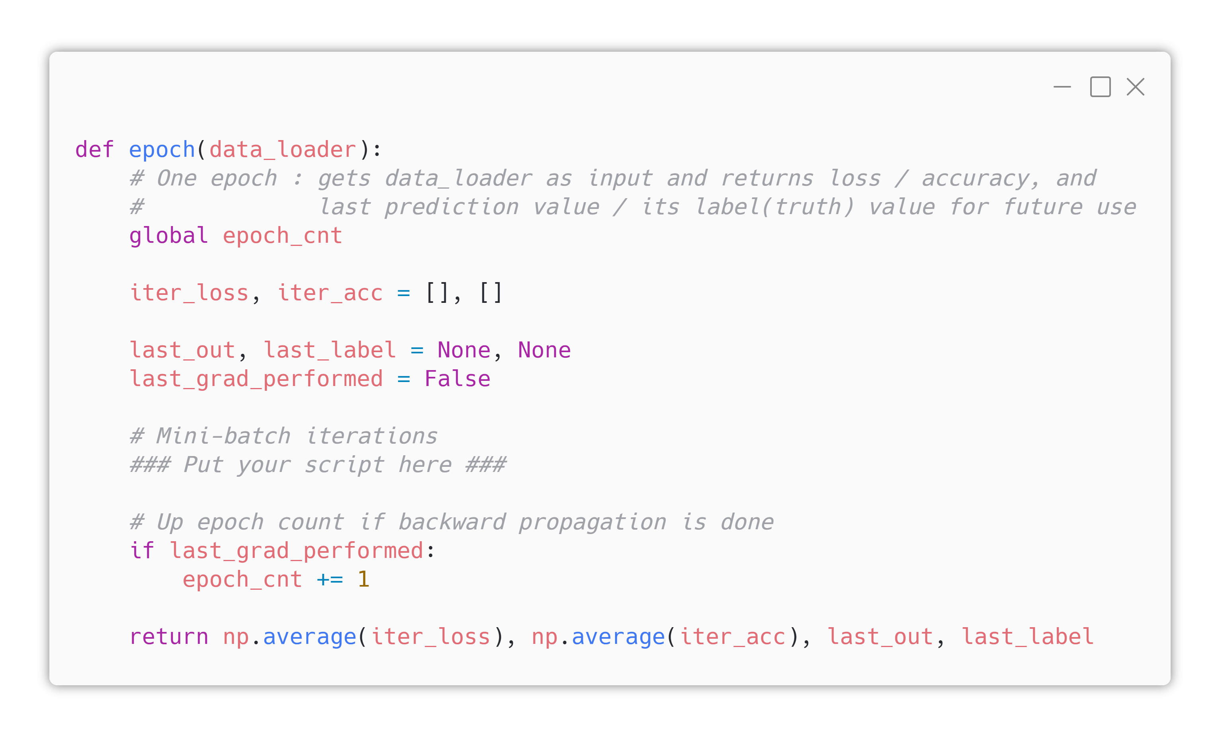
4. Function Definitions
Defining Epoch Functions
Next Page!

Slide 38
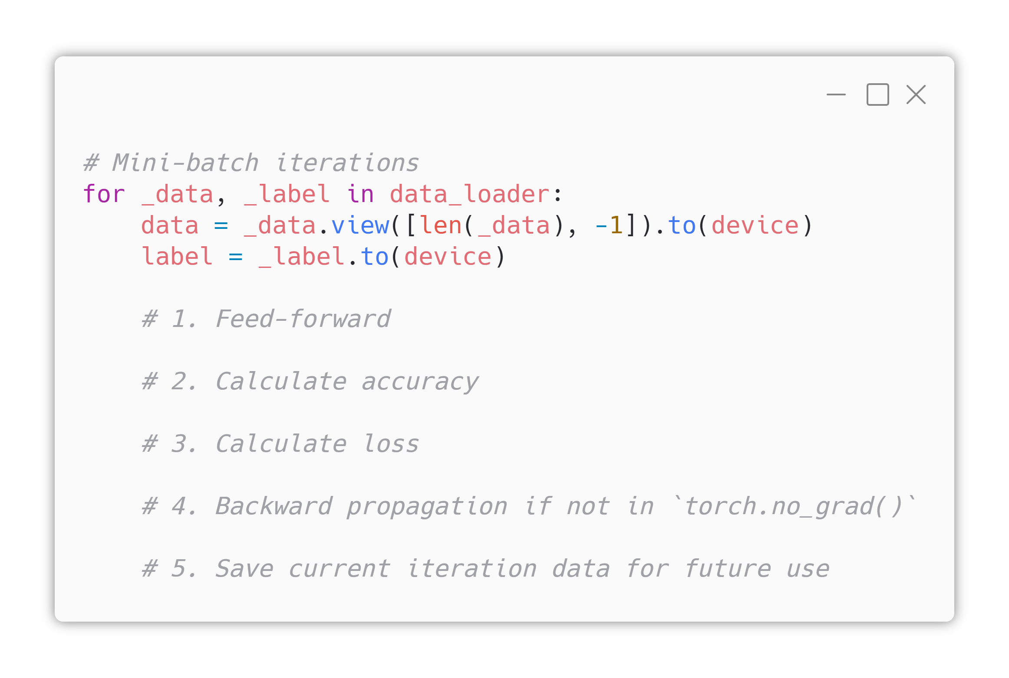
4. Function Definitions
Defining Epoch Functions

Slide 39



















4. Function Definitions
Defining Epoch Functions
$$Σ$$
SOFTMAX
NLLLoss
$$x_{0}$$
$$l_{0}$$
$$t_{0}$$
$$x_{1}$$
$$Σ$$
$$l_{1}$$
$$t_{1}$$
…
…
…
$$Σ$$
$$l_{8}$$
$$t_{8}$$
$$x_{782}$$
$$x_{783}$$
$$Σ$$
$$l_{9}$$
$$t_{9}$$
$$arg max$$
$$y$$

Slide 40

4. Function Definitions
Defining Epoch Functions
$$Σ$$
SOFTMAX
NLLLoss
$$x_{0}$$
$$l_{0}$$
$$t_{0}$$
$$x_{1}$$
$$Σ$$
$$l_{1}$$
$$t_{1}$$
…
…
…
$$Σ$$
$$l_{8}$$
$$t_{8}$$
$$x_{782}$$
$$x_{783}$$
$$Σ$$
$$l_{9}$$
$$t_{9}$$
$$arg max$$
$$y$$

Slide 41

4. Function Definitions
Defining Epoch Functions
arg max in “classes” dimension
Compare &
Calculate Correct Answer Ratio (Accuracy)
.1.
Real Label
.2.
out.shape = batch_size*1
(predicted label for each data)
onehot_out.shape = batch_size*10
(score for each classes, each data)

Slide 42

4. Function Definitions
Defining Epoch Functions
$$Σ$$
SOFTMAX
NLLLoss
$$x_{0}$$
$$l_{0}$$
$$t_{0}$$
$$x_{1}$$
$$Σ$$
$$l_{1}$$
$$t_{1}$$
…
…
…
$$Σ$$
$$l_{8}$$
$$t_{8}$$
$$x_{782}$$
$$x_{783}$$
$$Σ$$
$$l_{9}$$
$$t_{9}$$
$$arg max$$
$$y$$

Slide 43

4. Function Definitions
Defining Epoch Functions
$$Σ$$
SOFTMAX
NLLLoss
$$x_{0}$$
$$l_{0}$$
$$t_{0}$$
$$x_{1}$$
$$Σ$$
$$l_{1}$$
$$t_{1}$$
…
…
…
$$Σ$$
$$l_{8}$$
$$t_{8}$$
$$x_{782}$$
$$x_{783}$$
$$Σ$$
$$l_{9}$$
$$t_{9}$$
$$arg max$$
$$y$$

Slide 44

4. Function Definitions
Defining Epoch Functions
https://laf.gg/aibd-epoch
If you finished, compare your code with above!

Slide 45


4. Function Definitions
Defining Logging Functions

Slide 46

4. Function Definitions
Defining Logging Functions

Slide 47

4. Function Definitions
Defining Logging Functions

Slide 48

5. Training Iteration
with torch.no_grad():
PyTorch code in this section will be operated with autograd to be turned off. So, gradient is not calculated.
No gradient calculation is needed for validation & test set
In this section, net(data).requires_grad will be False

Slide 49

5. Training Iteration
Expected Output

Slide 50


6. Result Analysis
Accuracy Test
Expected Output

Slide 51

6. Result Analysis
Confusion Matrix

Slide 52

6. Result Analysis
Confusion Matrix
Expected Output

Slide 53

7. Saving Model

Slide 54

여기까지 오셨다니 … AI 마스터가 될 자격이 충분하시군요

Slide 55

오늘의 마지막 관문이네요~ Weight Initialization!

Slide 56
Weight Initialization
How weight initialization impact the performance?

Slide 57


Let’s add some layers …

Slide 58

And Try Training.
What’s the result?

Slide 59

Let’s apply normal distribution to initial weights …

Slide 60

And Try Training Again.
What’s the result?

Slide 61

What made this result?
When a model is initialized with zero, they will have same gradient!
So if you want your model work properly, don’t touch to initial value or don’t set it zero!

Slide 62
Finding Proper Hyper-parameters
Is there any way to find best hyper-parameters?

Slide 63
No effective method to find hyper-parameters
Brute-force is the answer!!
For the rest of lab session, modify only hyper-parameters to get the best accuracy.
Student with the highest accuracy will receive a special prize! Good Luck!
You can check the full version of today’s .ipynb at https://laf.gg/aibd-full-2

